Slide 1
CLIMATE CHANGE
Dr. Madhu Bala
Assistant Professor
Patliputra University

Slide 2
agenda
INTRODUCTION and CONCEPT
Climate Change : Causes & Impact
Impact of Climate Change in India
Climate Change & Environment
Gender Sensitization and Climate Change

Slide 3

Concept of Climate
- Climate is an important part of Physical environment
- Life on Earth is due to Water and Air
- Climate impacts all human actions
- Daily Life of Humankind, behaviour, food habits, living style have impact of climate.
- Climate is responsible for advent and decay of all living organisms.

Slide 4
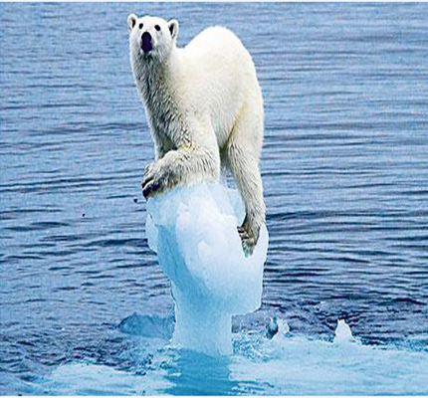
What is Climate Change ?
_Climate change brings imbalance in life of living organisms.
_ Climate change directly means changes which happen in long run in temperature, rain, moisture and other components
_Climate Change means those changes which we are feeling
_Climate Change is side effect of human activities
_As per Report of IPCC, due to climate change average temperature of World is rising.
_Between 1961 to 1990, average temperature of Earth rose from 14 degree to 14.52 degree

Slide 5
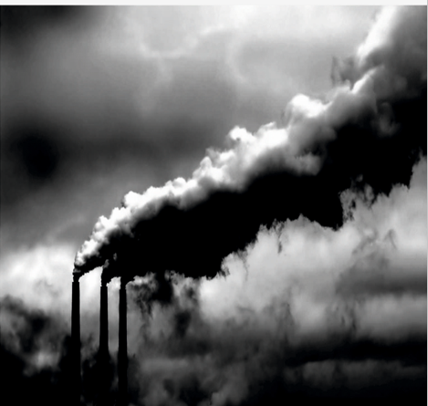
Causes of Climate Change
#Green House Gases include mainly Water vapour, CO2, Methane, Nitrous Oxide, Ozone, Chlorofloro Carbon
#Water Vapour reaches to 4% in Tropical areas while is has low level near Poles
#CO2 condenses due to burning of fossil fuel, deforestation and change of land use
#Nitrous Oxide is formed due to use of nitrogenous fertilizers and remain active for 100 years. It causes 298 times more global warming than CO2
# Methene Gas causes 25 times more global warming than CO2
#Chlorofloro carbon is formed by the use of deodorant, fridge, use of AC and remain active for 1700 years. It has 1000 times more capacity of global warming

Slide 6
PROBABLE IMPACTS OF CLIMATE CHANGE
Problems risen due the climate change have started fading different colours of earth
Climate change have great impact worldwide due to change in temperature
Antarctica’s temperature doubled in last 100 years
The frozen area shrinked due to change in climate
World’s glaciers are melting due to rising temperature
If temperature will rise at this pace, then 80 % glaciers of Alps mountains will melt
India’s temperature registered a rise of 0.5% in last 100 years
Himalaya’s glaciers reduced by 21% due to climate change
In future, arid area have more rainfall while agricultural areas will have less rainfall

Slide 7
Impact of Climate Change (Across Different Regions of the World)
Climate change is affecting various regions of the world.
By 2050, there will be a shortage of clean drinking water in Central and Western Africa and Southeast Asia.
In coastal areas, rising sea levels will increase the risk of floods and storms.
In South Asia, East Asia, and Southeast Asia, after floods and droughts, the number of deaths from various diseases will rise.
By 2020, Australia’s biodiversity will become very limited.
By 2030, farming in Southern and Eastern Australia and in Eastern New Zealand will suffer damage.
Southern Europe will be most affected by climate change, with extreme heat increasing significantly.
In North America, the problem of heat waves will become more severe. Several recent hurricanes confirm this: Katrina, Rita.

Slide 8
Impact of Climate Change on India
Due to climate change, the environment is becoming warmer and an increase of up to 4°C in temperature has been observed.
According to scientists, if the amount of carbon dioxide in the atmosphere doubles, India’s temperature may rise between 2.33°C and 4.78°C.
Since 1950, a decrease in rainfall caused by monsoon changes has been observed.
With a 2°C rise in the global average temperature, the monsoon will become unpredictable. Incidents of cloudbursts have increased recently.
Due to sudden changes in the monsoon, the frequency of unexpected floods and droughts in different regions will increase.
Because of global warming, in the years 1987 and 2002–03, most parts of India were affected by drought. During this period, agricultural production declined sharply.
Most of the Himalayan glaciers, which provide a major portion of snow that feeds the monsoon system, have been continuously melting since the last century.

Slide 9
Impact of Climate Change on India (Continued)
If the temperature rises by more than 2.5°C, Himalayan glaciers will start melting rapidly, and the existence of rivers like the Indus and the Brahmaputra will be in danger.
According to the Indian Space Research Organisation (ISRO), the sea level along the Indian coast is rising at a rate of 2.5 millimeters per year.
It is estimated that if this rise in sea level along India’s coastline continues, the sea level may rise by 15 to 36 centimeters by the year 2050.
As a result, many areas may get submerged, such as Mumbai, where during high tide seawater often enters most parts of the city.
Around a dozen islands near the Sundarban Delta of India are at risk of submergence.
Kolkata and Mumbai, which are densely populated cities, will be affected not only by rising sea levels but also by tropical cyclones and floods.
Due to water scarcity, rising temperatures, and the spread of saline water into coastal areas, there will be a significant decline in food production.
Because of the adverse effects of rising temperatures, there will be a sharp decline in food grain production in India by the year 2050.

Slide 10
Climate Change and National/State-Level Agricultural Production
Climate change will have a direct impact on agricultural yield and food grains.
In dry tropical regions, rising temperatures, floods, and drought conditions are likely to reduce agricultural production.
As a result of climate change, the area under crops such as sorghum, pearl millet, maize, and pulses will expand in north-central India.
In the plains of northern India, the production of wheat and rice will decline.
In 2009, a special committee report of the United Nations indicated that with every 1°C rise in average temperature, wheat production in India could decrease by about 6 million tons annually.
Due to rising temperatures, the rate of nitrogen fixation in pulse crops will increase, leading to higher yields.
Oilseed crop production will decline, whereas soybean and groundnut production will increase.
In India, the production of fruits such as mango, banana, papaya, chikoo (sapota), pineapple, custard apple, bael, dates, jamun, grapes, watermelon, and muskmelon will increase; whereas the production of fruits like apple, plum, and pear will decrease.
Due to a decline in water bodies, fisheries and shrimp farming will be adversely affected

Slide 11
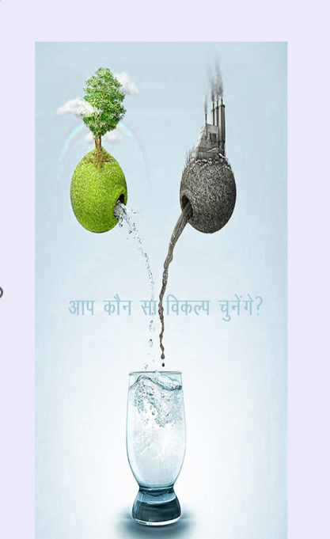
Loss of GDP Due to Climate Change
Due to climate change, South Asia’s Gross Domestic Product (GDP) is estimated to decline by 9.0% by the year 2100.
Due to climate change, South Asia’s Gross Domestic Product (GDP) is estimated to decline by 1.8% by 2050.
Between 1990 and 2008, more than 750 million people in South Asia were affected by disasters caused by climate change.
According to the Asian Development Bank report, due to global failure in addressing climate change, India’s Gross Domestic Product (GDP) may decline by 8.7%

Slide 12
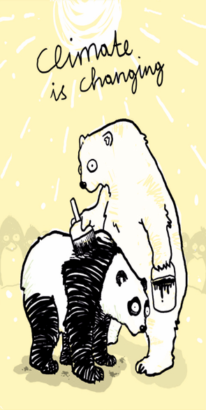
Possible Changes Due to Rising Temperature
With a 1°C Rise in Temperature
Up to 50 million people may be affected due to melting glaciers.
The existence of marine life found in the Arctic may be threatened.
There could be dramatic changes in the monsoon.
With a 2°C Rise in Temperature
Around 1 million people living on various islands may face flooding.
The risk of floods will increase due to rising sea levels caused by global warming.
With a 3°C Rise in Temperature
Approximately 1 to 4 billion people worldwide may face water scarcity.
Every year, 1 to 3 million people may die due to malnutrition.
Millions of people may face drought.
With a 4°C Rise in Temperature
In countries like Africa, food production may decline by 15–35%.
Additionally, around 80 million people may become vulnerable to malaria and other diseases.
With a 5°C Rise in Temperature
The glaciers of the Himalayas could disappear.
One-fourth of China’s population may be affected.
The melting of glaciers will also impact India.

Slide 13
Environmental Problems Due to Climate Change
At present, humans are facing many environmental problems due to climate change.
As a result of climate change, the intensity of natural disasters is increasing.
Severe storms are threatening the coastal regions of the Pacific and Atlantic Oceans.
In the Himalayan regions, due to the rapid melting of glaciers such as Gangotri, there will first be floods and later drought conditions.
Due to the melting of glaciers, sea levels are rising, resulting in storm surges and destruction in coastal areas.
Due to rising temperatures, incidents of forest fires have also increased.
Deforestation and climate change are causing widespread destruction through events such as landslides.
Due to climate change, ozone depletion is occurring rapidly.
According to a report released by the World Meteorological Department on the occasion of International Ozone Day in 2008, by 2008 the size of the ozone hole had reached 27 million square kilometers.
As a result of this destruction, migration of people from affected areas impacts social and economic systems.

Slide 14
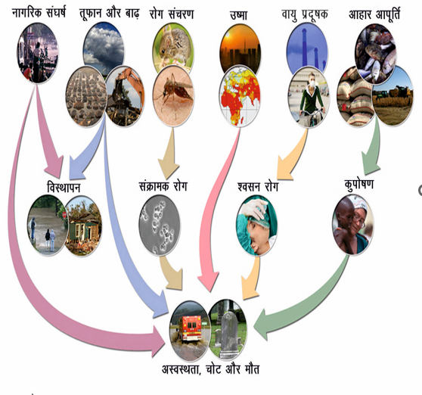
Climate Change and Health
Climate change is having a serious impact on human health.
In situations of floods and drought, displacement increases the risk of malnutrition, hunger, and infectious diseases.
According to the World Health Organization (WHO), since 1970, due to the effects of climate change, about 150,000 people per year in developing countries have been dying.
Due to changes in climate, diseases such as dengue and malaria are expected to spread rapidly into new areas.
An increase in pollen levels will expand the range of allergies.
The increase in fog or smog will cause respiratory problems.
Rising temperatures will lead to an increase in respiratory diseases.
Nitrogen oxides will cause eye irritation and increase lung infections.

Slide 15
Climate Change and Health
Climate change is having a serious impact on human health.
In situations of floods and drought, displacement increases the risk of malnutrition, hunger, and infectious diseases.
According to the World Health Organization (WHO), since 1970, due to the effects of climate change, about 150,000 people per year in developing countries have been dying.
Due to changes in climate, diseases such as dengue and malaria are expected to spread rapidly into new areas.
An increase in pollen levels will expand the scope of allergies.
The increase in fog or smog will lead to respiratory problems.
Rising temperatures will cause an increase in respiratory diseases.
Nitrogen oxides will cause eye irritation and increase lung infections

Slide 16
Biodiversity Affected by Climate Change
Life on Earth exists in diverse forms, ranging from microscopic organisms to gigantic animals.
Climate change is having a widespread impact on biodiversity.
Due to sudden environmental changes and the inability to adapt, many species may become extinct.
According to the IPCC (Intergovernmental Panel on Climate Change), if the exploitation of nature continues in this manner, the temperature may increase by 1.5% to 6% by the year 2100.
As a result, around 12,000 species of wild animals and plants are at risk of extinction.
According to the World Conservation Union at a biodiversity conference held in Bonn, due to pollution, three species are becoming extinct every hour.

Slide 17
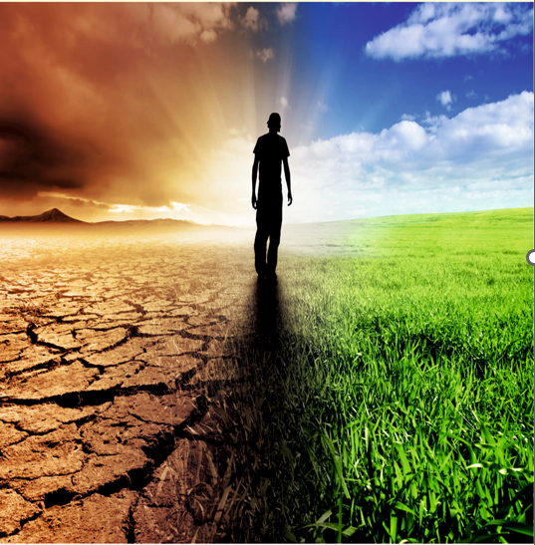
Biodiversity Affected by Climate Change
Life on Earth exists in diverse forms, ranging from microscopic organisms to gigantic animals.
Climate change is having a widespread impact on biodiversity.
Due to sudden environmental changes and the inability to adapt, many species may become extinct.
According to the IPCC (Intergovernmental Panel on Climate Change), if the exploitation of nature continues in this manner, the temperature may increase by 1.5% to 6% by the year 2100.
As a result, around 12,000 species of wild animals and plants are at risk of extinction.
According to the World Conservation Union at a biodiversity conference held in Bonn, due to pollution, three species are becoming extinct every hour.

Slide 18
International Initiatives for Climate Change / Global Efforts to Tackle Climate Change
To address the challenges arising from climate change, many conferences, treaties, and policies have been formulated at the international level.
In 1972, the Stockholm Conference was held, which led to the establishment of the United Nations Environment Programme (UNEP).
5 June was declared World Environment Day.
In 1988, the Intergovernmental Panel on Climate Change (IPCC) was established.
According to the first IPCC report in 1990, the Earth’s average temperature had increased by 0.5°C compared to the previous century.
In 1992, at Rio de Janeiro, Agenda 21 was declared — focusing on biodiversity conservation, food security, clean drinking water, social security, poverty alleviation in developing countries, and population control.
To tackle the problem of global warming, the first international agreement was the Kyoto Protocol (1997).
In 2002, the Earth Summit (Rio+10) was organized in Johannesburg.
In 2005, the Montreal talks on global warming began.
In 2009, the COP-15 Conference on Climate Change was held in Copenhagen, Denmark. During this conference, the BASIC group (Brazil, South Africa, India, and China) was formed.
In 2010, a climate change conference was held in Cancún, Mexico.
At this conference, the Green Climate Fund was established to help developing and poor countries with support from developed nations.

Slide 19
Strategies Adopted in India to Address Climate Change
Considering the possible consequences of climate change, the Planning Commission recommended the formulation of a National Action Plan in the 11th Five-Year Plan to prevent its impact.
As part of its international commitments under the UNFCCC, India has prepared an official National Information System (NTCOM). This provides data on greenhouse gases emitted in India and assesses their sensitivity and impacts.
India has prepared a National Action Plan on Climate Change (NAPCC), under which eight national missions are being implemented. Some of these include:
▪ National Water Mission – aimed at conserving water and minimizing misuse. ▪ National Mission for Sustaining the Himalayan Ecosystem – focused on protecting and ensuring long-term management of glaciers and mountain ecology. ▪ National Mission for a Green India – with the goal of bringing 33% of the country’s total land area under forest cover. ▪ National Mission on Sustainable Agriculture – aimed at ensuring coordinated policy along with research and technological development.

Slide 20

Gender Sensitization and Climate Change

Slide 21
Why Women are more Vulnerable
• Livelihood dependence: In countries like India, women are heavily involved in agriculture, animal husbandry, and forest-based work—sectors most affected by climate variability.
• Water & fuel burden: Droughts and deforestation increase the time women spend collecting water and firewood, affecting health and education.
• Limited access to resources: Women often lack land ownership, credit, technology, and climate information.
• Disaster risks: During floods, cyclones, and heatwaves, women face higher mortality due to mobility restrictions, caregiving roles, and lack of early warnings

Slide 22
thank you
dr. Madhu bala
+91-9431480431
  madhubsdma@gmail.com

